Slide 1





Natural Language Processing (NLP)

Slide 2

Linguistic Ambiguity
+
الغموض اللغوى
2
I saw a girl with a telescope

Slide 3








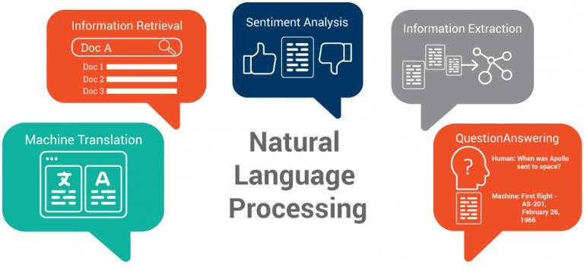


















+ Natural Language Processing (NLP)
3
Natural language processing (NLP) is a
, ,
of
concerned and
, and
with the between
(natural) languages, in particular
.
Challenges in natural language processing frequently
involve
.

Slide 4
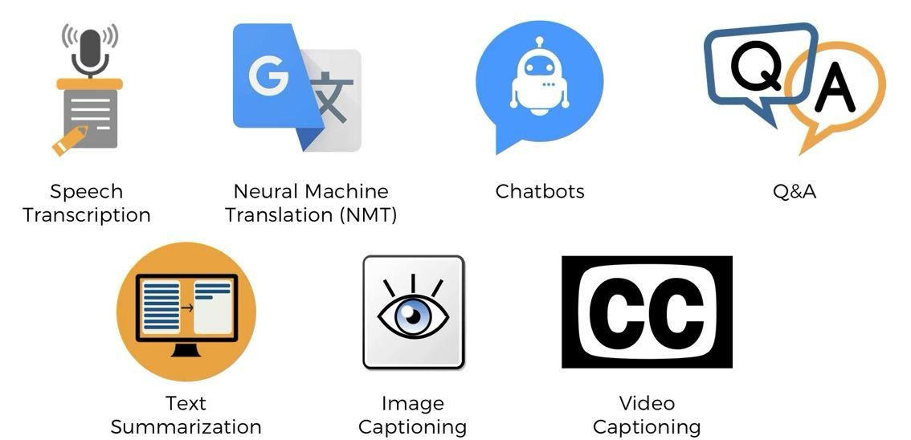
+ Applications
4

Slide 5
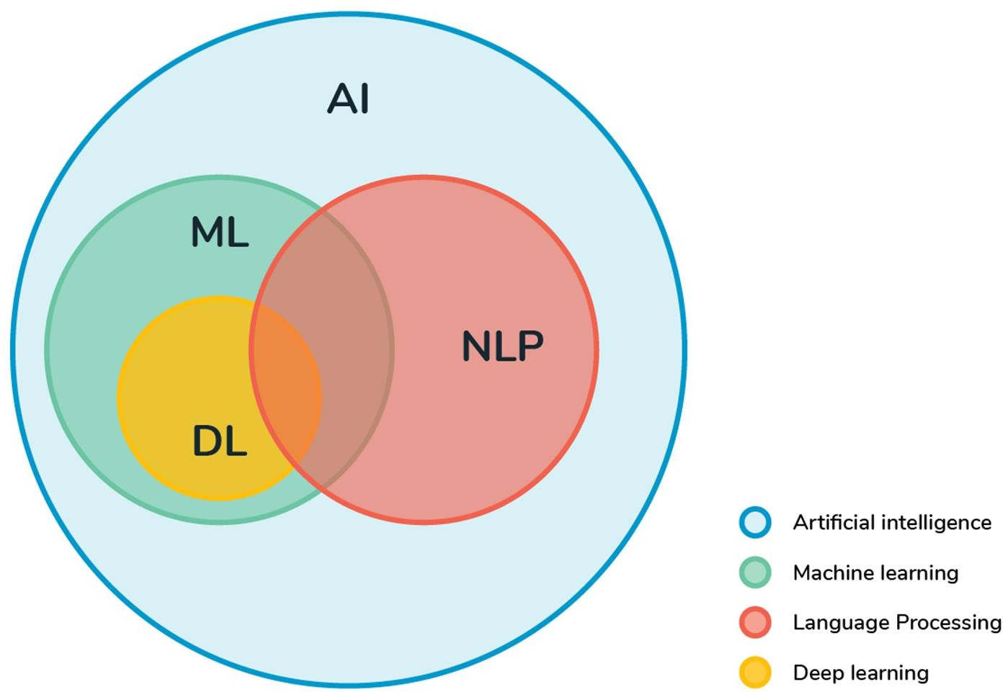
+ Deep Learning & NLP
6

Slide 6
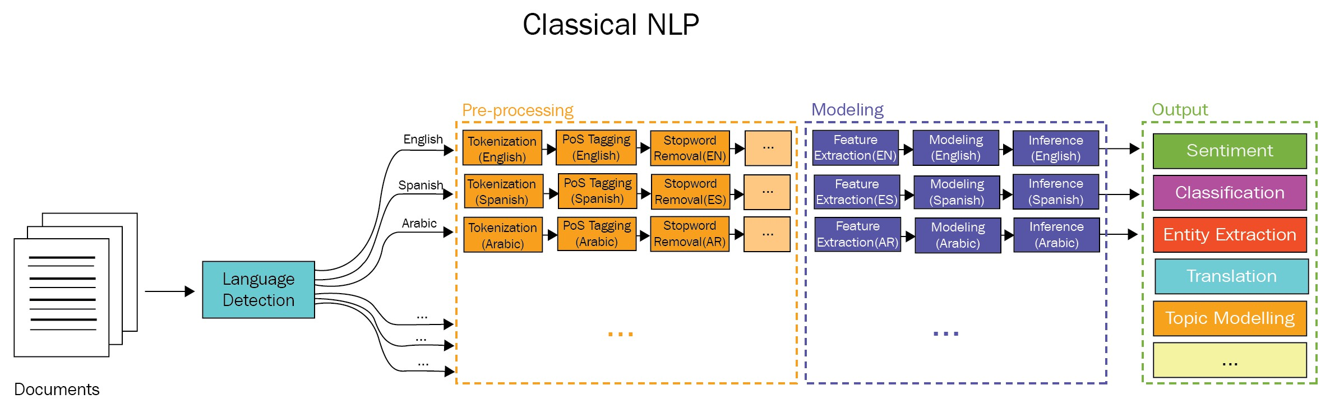
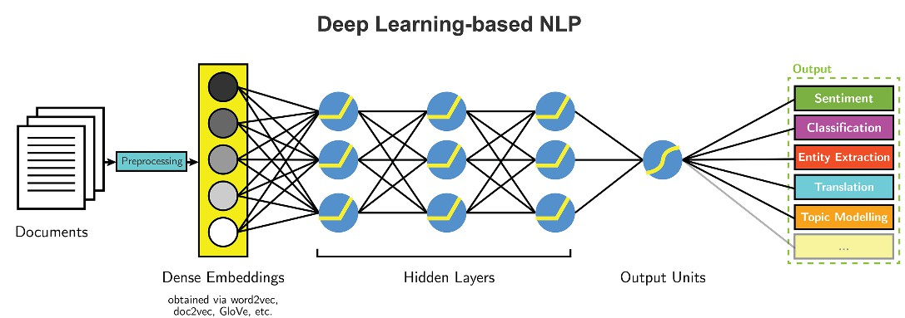
(Source: Thanaki)
+
7
(Source: Thanaki)
Notes:
There are several types of Natural Language Processing (NLP) models, including:
1. **Rule-based models**: These models use handcrafted rules and patterns to process text. They are often simplistic but can be effective for specific tasks.
2. **Statistical models**: Statistical NLP models rely on statistical techniques, such as probability theory and machine learning algorithms, to analyze and generate text. Examples include Hidden Markov Models (HMMs) and Conditional Random Fields (CRFs).
3. **Neural network-based models**: These models leverage neural networks to learn patterns and relationships in text data. They include architectures like Recurrent Neural Networks (RNNs), Long Short-Term Memory networks (LSTMs), and Transformer models.
4. **Pre-trained language models**: These models are trained on vast amounts of text data and then fine-tuned for specific NLP tasks. Examples include models like BERT (Bidirectional Encoder Representations from Transformers), GPT (Generative Pre-trained Transformer), and RoBERTa.
5. **Hybrid models**: Hybrid models combine elements of rule-based, statistical, and neural network-based approaches to leverage the strengths of each method for improved performance.
Each type of NLP model has its advantages and disadvantages, and the choice of model depends on the specific task, available data, computational resources, and desired performance metrics.

Slide 7




















+ Text Classification
8
Text classification is a common task in
transforms a
, which
.
How could you use that?
To find the of a review.
Find on a platform like Facebook, twitter, Instagram etc.
Find . A current ongoing competition on Kaggle
Find on websites
Many more…
toxic comments: negative comments Insincere : wrong or dishonest
February 14, 2022

Slide 8
















⁺ Preprocessing
9
Text is the most
form of all the available data, various types of
are present in it and the data is not any
.
The entire process of cleaning and standardization of text, making it noise-
free and ready for analysis is known as .
Consists of :
■
(remove symbols, URL, punctuation, stop words etc. )
■
(Tokenization, Lemmatization, Stemming etc. )
■
(Tagging, Regular expression lookup)

Slide 9
















+ What is text and word?
10
Text as a of
Characters, Words, Phrases and named entities, sentences, paragraphs, etc.
■
■
as a sequence of
.
A word is a
■
In english we can split a sentence by spaces or punctation.
Challenges
In German there are compound words which are written without spaces.
In Japanese there are no spaces at all.

Slide 10
















+ Tokenization
11
Tokenization is a process that
token as a
an
into
■
This is Amna’s book, isn’t it?
This
is
Amna’s
book,
isn’t
it?

Slide 11































+ Tokenization
12
■
This is Amna’s book, isn’t it?
This
is
Amna
’
s
book
,
isn
’
t
it
?
■
This is Amna’s book, isn’t it?
This
is
Amna
’s
book
,
is
n’t
it
?
■

Slide 12











































+ Token Normalization
13
is a key step for with text as it converts the to the (1
feature), which is an ideal task for any machine learning model.
■
Another type of is about the
.
For example –
variations of the word
are the different
Though they
but
.
■

Slide 13


+ Stemming/Lemmatization
14
Process of getting the in its form :
“Coder”, “coding” can be simplified into “code”.
What
For a machine, “coder”, “coders”, coding”, “code” are all different words with each of its meaning, which might not be the best interpretation
Why
Look-up table of lemma of words based on their parts-of-
speech form and some custom rules of English
How

Slide 14

























+ Token Normalization
15
■
A process of and word which is called the
Usually refers to
Stemming is a
to get to the
of the
.
that
.
process of stripping the suffixes
) from a word.
■
Porter stemmer
Rudimentary = Basic

Slide 15










+ Porter Stemmer
16
■
of words reduction,
.
Rule | Example
SSES → SS | Caresses → Caress
IES → I | Ponies → poni
SS → SS | caress → caress
S → _ | cats → cat
■
feet→feet, cats→cat,
Problem
→
, talked→talk
fails on irregular forms, produces non-words

Slide 16













+ Token Normalization
17
■
Is an &
form of the word, it makes use of importance of words) and structure and grammar relations).
of obtaining the
(dictionary analysis (word
Returns the form of a word,
Which is known as the
.

Slide 17





+ WordNet Lemmatizer
18
Uses the knowledgebase to
■
feet→foot, cats→cat, wolves→wolf,
Problem
.
talked→talk
not all forms are reduced
Solution
We need to try stemming or lemmatization and choose best for our task

Slide 18













+ Normalizing Capital Letters
19
Normalizing
■
→ us (if both are pronoun)
(could be pronoun, or the name of a country)
■
We can use heuristics:
Lowercasing the
Lowercasing
.

Slide 19
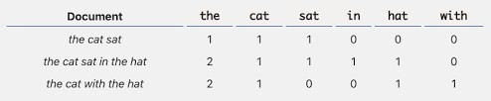




















+ Bag of words (BOW)
20
■
Count
For each token we will have a feature column, this is called
Way of features from for use in , such as with .
The approach is very and
many ways for
and can be used in
from documents.

Slide 20


























+ Bag of words (BOW)
21
It involves :
A vocabulary of known words.
A measure of the presence of known words.
It is called a of words, because any
of words in the document is
The model is only concerned with where in the document.
about the
.
in the
,
■

Slide 21
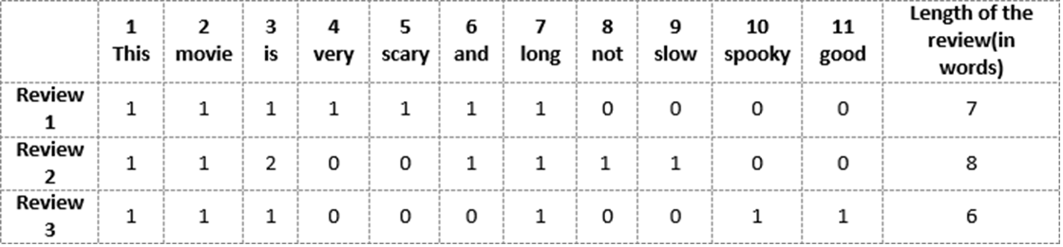
+ Bag of words (BOW)
22
Review 1: This movie is very scary and long
Review 2: This movie is not long and is slow
Review 3: This movie is spooky, good, long.
Vector of Review 1: [1 1 1 1 1 1 1 0 0 0 0]
Vector of Review 2: [1 1 2 0 0 1 1 0 1 0 0]
Vector of Review 3: [1 1 1 0 0 0 1 0 0 1 1]

Slide 22






















+ Steps to create Bag of words (BOW)
23
■
Convert text to lower case.
Remove all non-word characters.
Remove all punctuations.
■
Apply the following steps to generate model.
Declare a dictionary to hold bag of words.
Next, tokenize each sentence to words.
Now for each word in sentence, check if the word exists in dictionary.
If it does, then increment its count by 1. If it doesn’t, add it to dictionary and set its count
as 1.
■
In this step construct a vector, which would tell whether a word in each sentence is a
frequent word or not. If a word in a sentence is a frequent word, set it as 1, else set it as 0.

Slide 23



























+ Limitations of BOW
24
If the
contain
and thereby, the
, then
would
would
of the
.
■
The vocabulary requires
the , which the
: القلة فى الظهور
Sparse representations are
, most in order to manage
of the document representations.
■
to model both for
(space and time complexity) and also for is for the to so
.
, where the in such a

Slide 24













+ Limitations of BOW
25
■
:
ignores the
in the document (semantics).
■
, and in turn meaning of words
Context and meaning can offer a lot to the model, that if modeled could tell
the difference between the same words differently arranged.
(“ “
” vs “ ”), synonyms ” vs
”), and much more.

Slide 25








+ Bag of words (BOW)
26
Let’s preserve some ordering
We can count token pairs, triplets, etc.
Also known as n-grams
1-Gram for tokens
2-Grams for token pairs
N-grams of texts are
in
and

Slide 26








+ N-Gram technique
27
An means a
■
“Machine Learning” is a 2-gram (a
“Machine Learning Course” is a
“A Machine Learning Course” is a
),
(trigram)
Why N-gram
N-grams are used for a variety of things.
Some examples include auto completion of sentences (such as the one we see in Gmail these days), auto spell check, and to a certain extent, we can check for grammar in a given sentence.

Slide 27
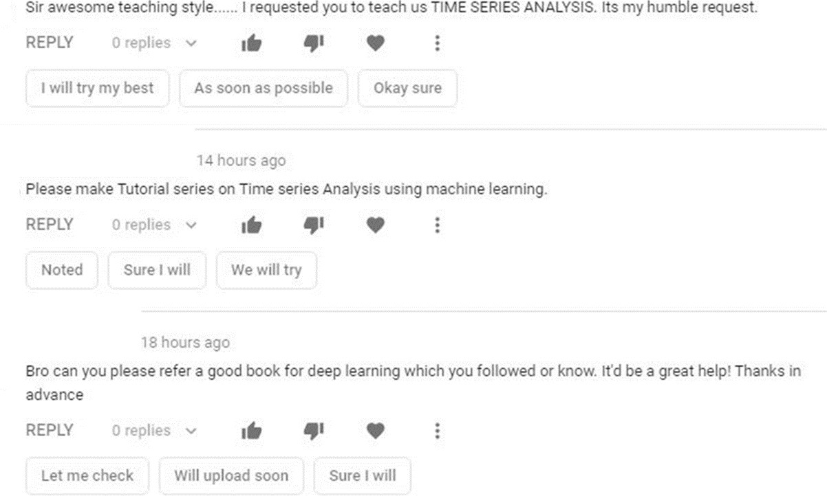
+ Bag of Words and N-gram application
28

Slide 28




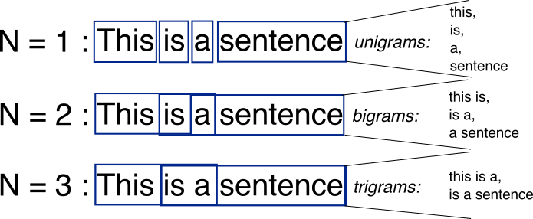
+ N-Gram technique
29
A sequence of
from a
(byte, a character or a word) called N-Grams, that are
in a document are used.
In an N-Gram scheme, it is very difficult to decide the number of grams to be
considered for effective document representation.

Slide 29






+ N-Gram technique
30
■
If X=Num of words in a given sentence k, N is the number of required gram.
The number of n-grams for sentence K would be:
𝒏 − 𝒈𝒓𝒂𝒎𝒔_{𝒌} = 𝐗 − (𝐍 − 𝟏)
Problem
too many features
Out of Vocabulary (OOV) words. These are words that appear during testing but not in training.

Slide 30













+ Remove Some N-Grams
31
Remove some N-Grams from features based on their occurrence frequency in documents of our corpus.
■
Articles, prepositions etc. (and, a, the, is)
They are called ; they won't help us to discriminate texts.
■
these stop words
■
■
, rare n-grams
We don’t need them either, otherwise we will likely
■
Those are
n-grams

Slide 31










+ Bag-of-Words Model
33
The technique lists
,
and optionally the
.
Machine learning classifiers can use the resulting model directly as feature vectors.
Part-of-Speech Tagging
Syntactic Parsing.
Term Frequency-Inverse Document Frequency

Slide 32

























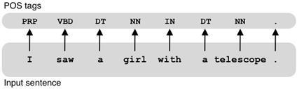
+ Part of speech tagging:
34
■
parsing involves the in the sentence for
in a manner that shows the among the
and their
.
Apart from the grammar relations, in a sentence is also
with a tag (nouns, verbs, adjectives, adverbs etc.).
The POS tags defines the of a word in the sentence.
■
:
Word sense disambiguation.
Improving word-based features
Normalization and Lemmatization
Efficient stopword removal
Notes:
"I" - pronoun (first person singular)
"saw" - verb (past tense of "see")
"a" - indefinite article
"girl" - noun (subject of the sentence)
"with" - preposition
"a" - indefinite article
"telescope" - noun (object of the preposition "with")

Slide 33
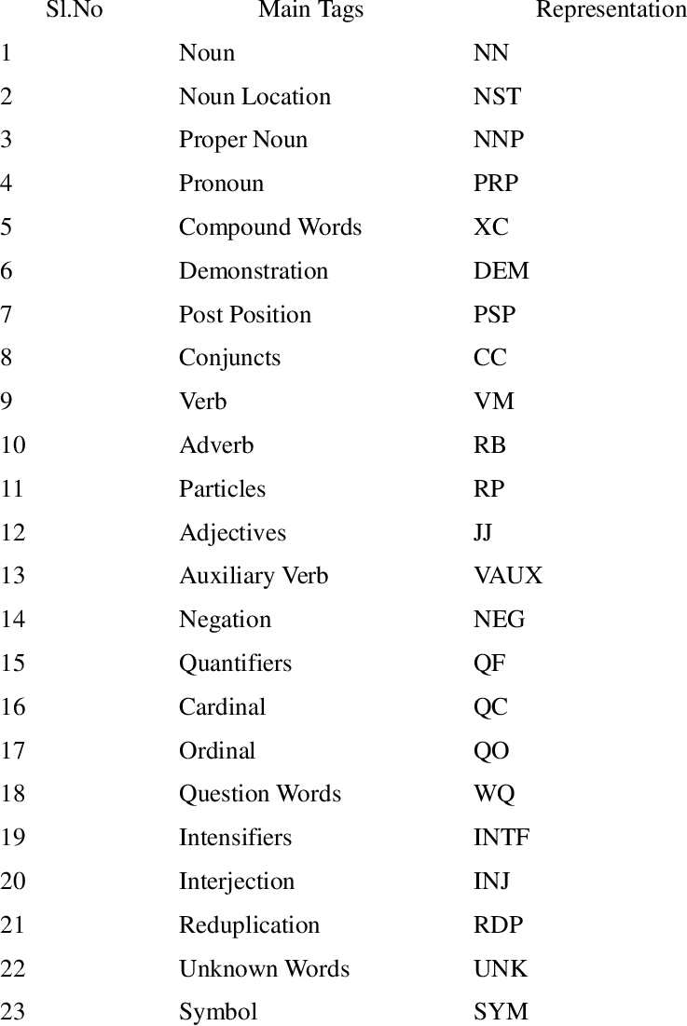
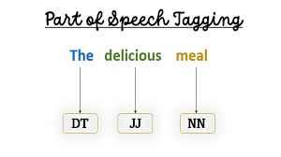
POS tags

Slide 34

























+ Part of Speech Tagging Applications
35
توضيح معنى الكلمة
Some language words have
. For example, in the two sentences below:
■
according to their
■
■
“ ” is used with
both of the cases are different.
, however the part of
for
In sentence I, the word “ ” is used as
, while in II it is used as
.

Slide 35




















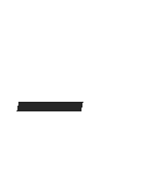






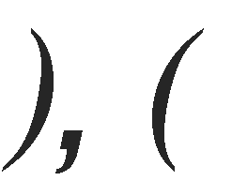
















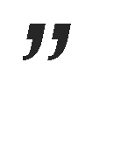











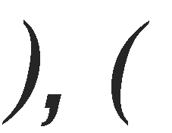




+ Part of Speech Tagging Applications
36
■
A learning model could learn
of a when used speech tag is linked with them, the
.
, however if the part of
, thus making
as the
For example:
■
■
■
PRP$- possessive pronoun, MD - Modal

Slide 36













+ Part of Speech Tagging
37
POS tags are the basis of lemmatization process for converting a word to its base form (lemma).
■
POS tags are also useful in efficient removal of
stopwords.
For example, there are some tags which always define the
.
Common stop words

Slide 37











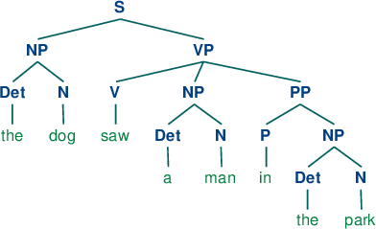


















+ Syntactic Parsing
38
in the
of text using a
according to their
■
is the
,
relation to
of a
each other.
Only using a an
can potentially produce
because of the
.
,
of
■
.

Slide 38
























































+ Term frequency-inverse document frequency (TF-IDF)
39
■
This summarizes appears within a document.
This that appear a lot
■
.
■
is a how commonly a word is used.
■
.
For example, the word
as it carries very
appears in
” information.
texts and would thus have a very
In contrast, if you take the word Thus,
, while it is common, it’s not used as widely as the word .
■
is a that is intended to reflect
.

Slide 39




































+ Term frequency-inverse document frequency (TF-IDF)
40
■
based feature selection method
is a common
, which lets us identify words in a a document’s topic.
in the whole , but
■
scheme for the
that can guide in
A term will have a score if it often in the .
As a result, very common words such as
in English will be
and have , instead of

Slide 40



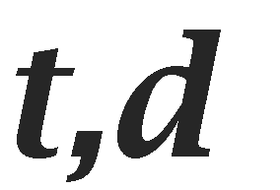
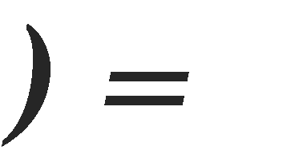













₊ Term Frequency and Inverse Document Frequency (TF-IDF)
41
■
Tf(t,d) is the frequency for term (or n-gram) t in
document d.
𝑻𝒆𝒓𝒎 𝒕 𝒇𝒓𝒆𝒒𝒖𝒆𝒏𝒄𝒚 𝒊𝒏 𝒅𝒐𝒄𝒖𝒎𝒆𝒏𝒕 𝒅
■
𝑻𝒐𝒕𝒂𝒍 𝒘𝒐𝒓𝒅𝒔 𝒊𝒏 𝒅𝒐𝒄𝒖𝒎𝒆𝒏𝒕
Inverse Document Frequency measure the
/corpus
Let enoting the total
of a
in the
then the
𝑰𝑫𝑭 = 𝒍𝒐𝒈_{𝟐}(
𝑵
𝑫
𝑇𝐹 − 𝐼𝐷𝐹 = 𝑇𝐹 × 𝐼𝐷𝐹
Notes:
TF(t, d)=Total number of terms in document d / Number of times term t appears in document d​
N: Total number of documents in corpus d
D: Number of documents containing term t​
IDF(t,d)=log(N/D)
𝑇𝐹 − 𝐼𝐷𝐹 = 𝑇𝐹 × 𝐼𝐷𝐹

Slide 41








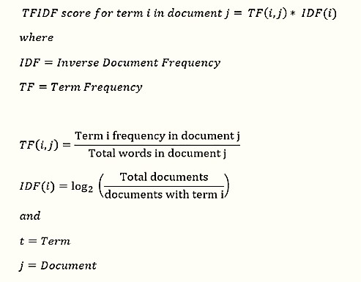









+ Example
: The car is driven on the road.
The truck is driven on the highway.
43
 | 2/7 | 2/7 | log(2/2)=0 | 0 | 0
 | 1/7 | 0 | log(2/1)=0.3 | 0.043 | 0
 | 0 | 1/7 | log(2/1)=0.3 | 0 | 0.043
 | 1/7 | 1/7 | log(2/2)=0 | 0 | 0
 | 1/7 | 1/7 | log(2/2)=0 | 0 | 0
 | 1/7 | 1/7 | log(2/2)=0 | 0 | 0
 | 1/7 | 1/7 | log(2/2)=0 | 0 | 0
 | 1/7 | 0 | log(2/1)=0.3 | 0.043 | 0
 | 0 | 1/7 | log(2/1)=0.3 | 0 | 0.043

Slide 42
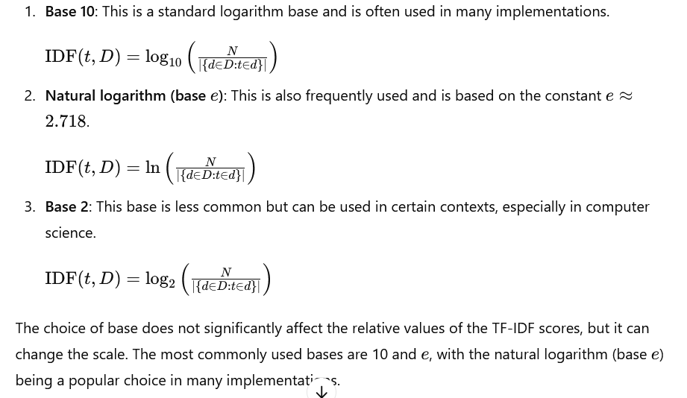

Slide 43




₊ Term Frequency and Inverse Document Frequency (TF-IDF)
44
Example: Assume we have three documents/sentences
T1: The game of life is a game of everlasting learning.
T2: The unexamined life is not worth living
T3: Never stop learning
Steps for TF-IDF
Term/Word | The | Game | Of | Life | Is | A | Everlasting | learning
Frequency | 1 | 2 | 2 | 1 | 1 | 1 | 1 | 1
Term/Word | The | unexamined | Life | Is | not | Worth | Living
Frequency | 1 | 1 | 1 | 1 | 1 | 1 | 1
Term/Word | Never | Stop | learning
Frequency | 1 | 1 | 1

Slide 44
₊ Term Frequency and Inverse Document Frequency (TF-IDF)
45
Normalize TF for T1, T2, and T3 as
Term/Word | The | Game | Of | Life | Is | A | Everlasting | learning
Frequency | 1/10 | 2/10 | 2/10 | 1/10 | 1/10 | 1/10 | 1/10 | 1/10
Term/Word | The | unexamined | Life | Is | not | Worth | Living
Frequency | 1/7 | 1/7 | 1/7 | 1/7 | 1/7 | 1/7 | 1/7
Term/Word | Never | Stop | learning
Frequency | 1/3 | 1/3 | 1/3
Note T1 contains 10 terms, T2 contains 7 terms and T3 contains 3 terms
Calculation of IDF for each term as

Slide 45

₊ Term Frequency and Inverse Document Frequency (TF-IDF)
46
Let is compute the IDF for the term “
”.
𝐼𝐷𝐹 = log(
𝑇𝑜𝑡𝑎𝑙 𝑛𝑢𝑚𝑏𝑒𝑟 𝑜𝑓 𝑑𝑜𝑐𝑢𝑚𝑒𝑛𝑡𝑠
)
𝑁𝑢𝑚𝑏𝑒𝑟 𝑜𝑓 𝑑𝑜𝑐𝑢𝑚𝑒𝑛𝑡𝑠 𝑤𝑖𝑡ℎ 𝑡𝑒𝑟𝑚 𝑢𝑛𝑒𝑥𝑎𝑚𝑖𝑛𝑒𝑑 𝑖𝑛 𝑖𝑡
3
𝐼𝐷𝐹(𝑢𝑛𝑒𝑥𝑎𝑚𝑖𝑛𝑒𝑑) = log( )=0.477, IDF(Life) = 0.176
1
Term/Word | The | Game | Of | Life | Is | A | Everlasting | learning
Frequency | 1/10 | 2/10 | 2/10 | 1/10 | 1/10 | 1/10 | 1/10 | 1/10
IDF | 0.176 | 0.176 | 0.176 | 0.176 | 0.176 | 0.477 | 0.477 | 0.176
Term/Word | The | unexamined | Life | Is | not | Worth | Living
Frequency | 1/7 | 1/7 | 1/7 | 1/7 | 1/7 | 1/7 | 1/7
IDF | 0.176 | 0.176 | 0.176 | 0.176 | 0.176 | 0.176 | 0.176
Term/Word | Never | Stop | learning
Frequency | 1/3 | 1/3 | 1/3
IDF

Slide 46
₊ Term Frequency and Inverse Document Frequency (TF-IDF)
47
Let us calculate the TF-IDF and the relevant documents for the query “LIFE
LEARNING”
Term | T1 | T2 | T3
Life | .0176 | .0.025 | 0
Learning | .0176 | 0 | .0587
Note: For each term the TF-IDF as calculated multiply its normalized term frequency with its IDF, e.g.
TF-IDF=TF *IDF

Slide 47

+
48
Apply TF-IDF and create the same table as in the previous example in slide 43
D1: Fair men
D2: Fair women
D3: men women Fair

Slide 48
+ Example
49
Word | TF |  |  | IDF | TF*IDF
 | D1 | D2 | D3 |  | D1 | D2 | D3
Fair | ½ | ½ | 1/3 | log(3/3) | ½*LOG(3/3) | 0*0.5 | 0*0.33
Men | ½ | 0/2 | 1/3 | log(3/2)=0.17 | 0.176*0.5 | 0*0.176 | 0.176*0.33
Women | 0/2 | 1/2 | 1/3 | log(3/2)=0.17 | 0.176*0 | 0.5*0.176 | 0.176*0.33
D1: Fair men
D2: Fair women
D3: men women Fair

Slide 49




























+ Term Frequency and Inverse Document Frequency (TF- IDF)
50
For each we derive a vector.
■
Each will have its
There are many different ways to measure
.
The
measure is a very common similarity measure
■

Slide 50
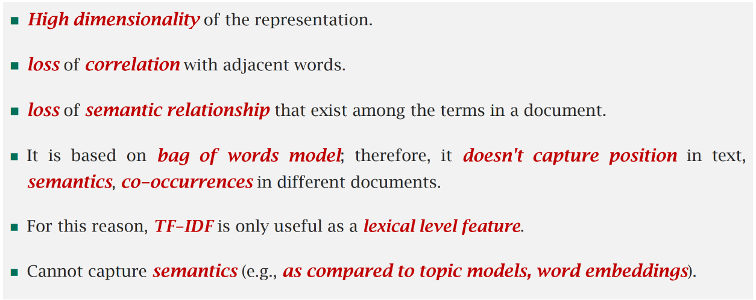
₊ Limitations of TF-IDF
51

Slide 51
End of Lecture
+
52

